Slide 1

CHIPPLY
BEST
PRACTICES
Get the most out of your Chipply platform.
The better way to build online stores.
Each slide stands alone — pull only what's relevant for your dealer.

Slide 2

BEST PRACTICES
OVERVIEW
What's inside
SETUP & FOUNDATION
Default Settings • Auto Pricing • Inventory Thresholds • Templates • Category Spotlight Images
22
SELLING & STORE TYPES
Automated Emails • Requestor Stores • eCertificates & Promos • Categories & Packages • Catalog Stores
ORDER MANAGEMENT
Refund, Find & Edit • Store Status • Order Manager • Customer Service
Topics covered
VENDORS & FULFILLMENT
Across 5 categories.
Vendor Purchasing • Integrations • Fulfillment Tools
Pull just the slides you need
for each dealer conversation.
REPORTING & GROWTH
Financial Admin • Accounting Reports • Sales Activity Reports • Resources Hub • Chipply Collective
What's inside
CHIPPLY • CONFIDENTIAL

Slide 3
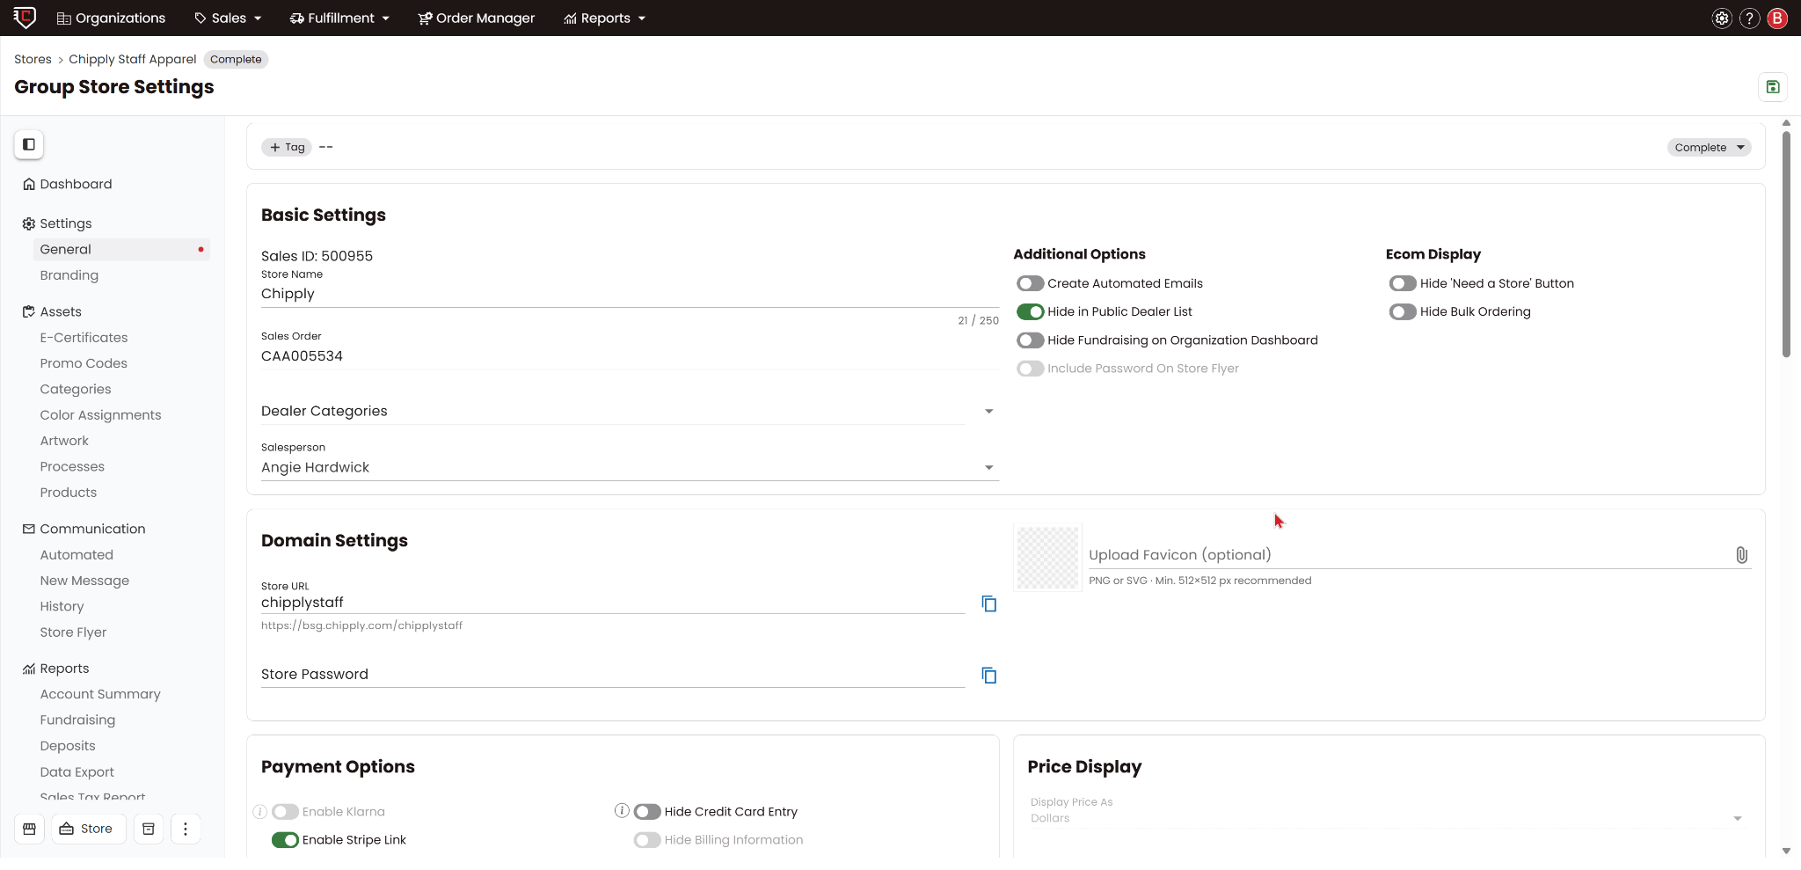
BEST PRACTICES
SETUP
Default Dealer & Store Settings
WHAT IT IS
Configure your dealer-level defaults — tax type, distribution methods, fees, payment options — so every new store inherits the same baseline.
WHY IT MATTERS
Set up what’s true 90% of the time in your Dealer Settings, and let the system do the heavy lifting. You’ll be able to launch new stores in minutes while automatically locking in correct taxes and fees.
Pro-Tip for Smooth Sailing: Make sure to finalize your Dealer Settings before you launch your stores. New settings only apply to stores created after the change. Getting them right from the start saves you from having to manually update older stores one by one later!
DOCUMENTATION
General Settings Page Quick Setup
Default Dealer & Store Settings
CHIPPLY • CONFIDENTIAL
Notes:
*elle updated 5/19

Slide 4
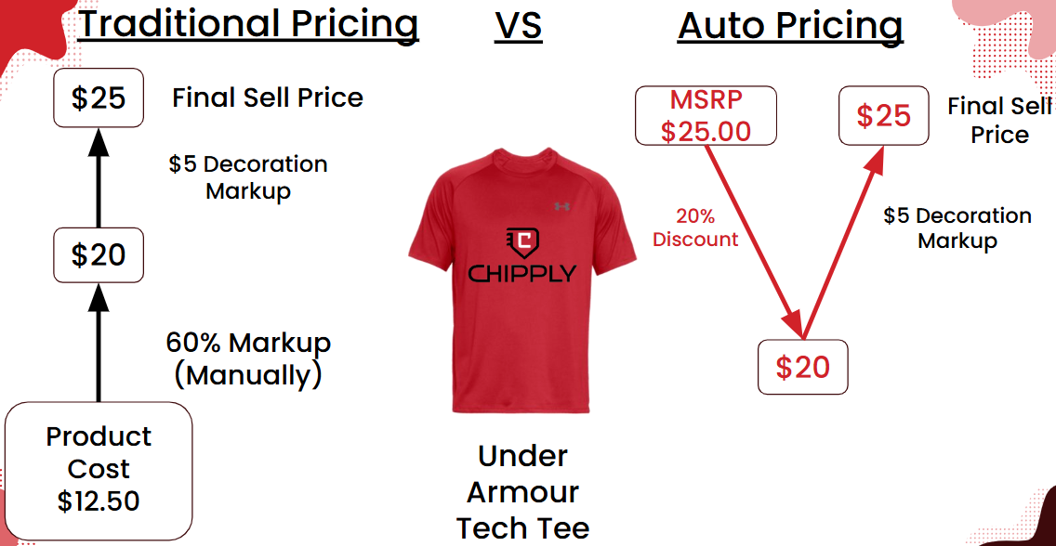
BEST PRACTICES
SETUP
Auto Pricing
WHAT IT IS
Consistent, Accurate, and Fast. Apply vendor discounts off MSRP and add decoration charges per process across the entire store with a single click. Supports customer tiers.
WHY IT MATTERS
Say goodbye to the manual lookup-and-calculate grind. Auto Pricing automates your markup and decoration rules so you can build stores in a fraction of the time.
Protect Your Margins: Rules apply automatically, removing human error.
Align Your Team: Keeps salespeople consistent and on the same page.
DOCUMENTATION
Auto Pricing Explained / Watch this 5 Min Video
Auto Pricing
CHIPPLY • CONFIDENTIAL
Notes:
*elle updated 5/19

Slide 5
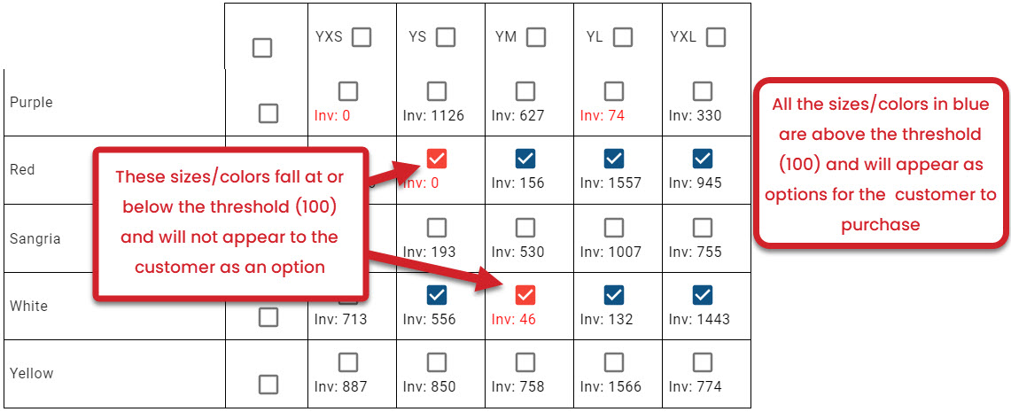

BEST PRACTICES
SETUP
Inventory Thresholds
WHAT IT IS
Your #1 Tool Against Backorders: Inventory thresholds is reacting in real time with vendor inventory. . Automatically hide sizes and colors below a vendor-inventory cutoff. Four ways to turn it on: on import, individual, bulk, or store-wide.
WHY IT MATTERS
This feature is the single biggest lever you have for reducing backorders. By letting the system automatically monitor real-time supplier data, you can take a hands-off approach to store management while keeping your end-customers happy.
Hands-Off Automation: If an item's stock bounces back up at the vendor, the system automatically makes it available in your store again—no manual checking required.
DOCUMENTATION
How to Turn On Inventory Thresholds
Inventory Thresholds
CHIPPLY • CONFIDENTIAL
Notes:
*elle updated 5/19

Slide 6
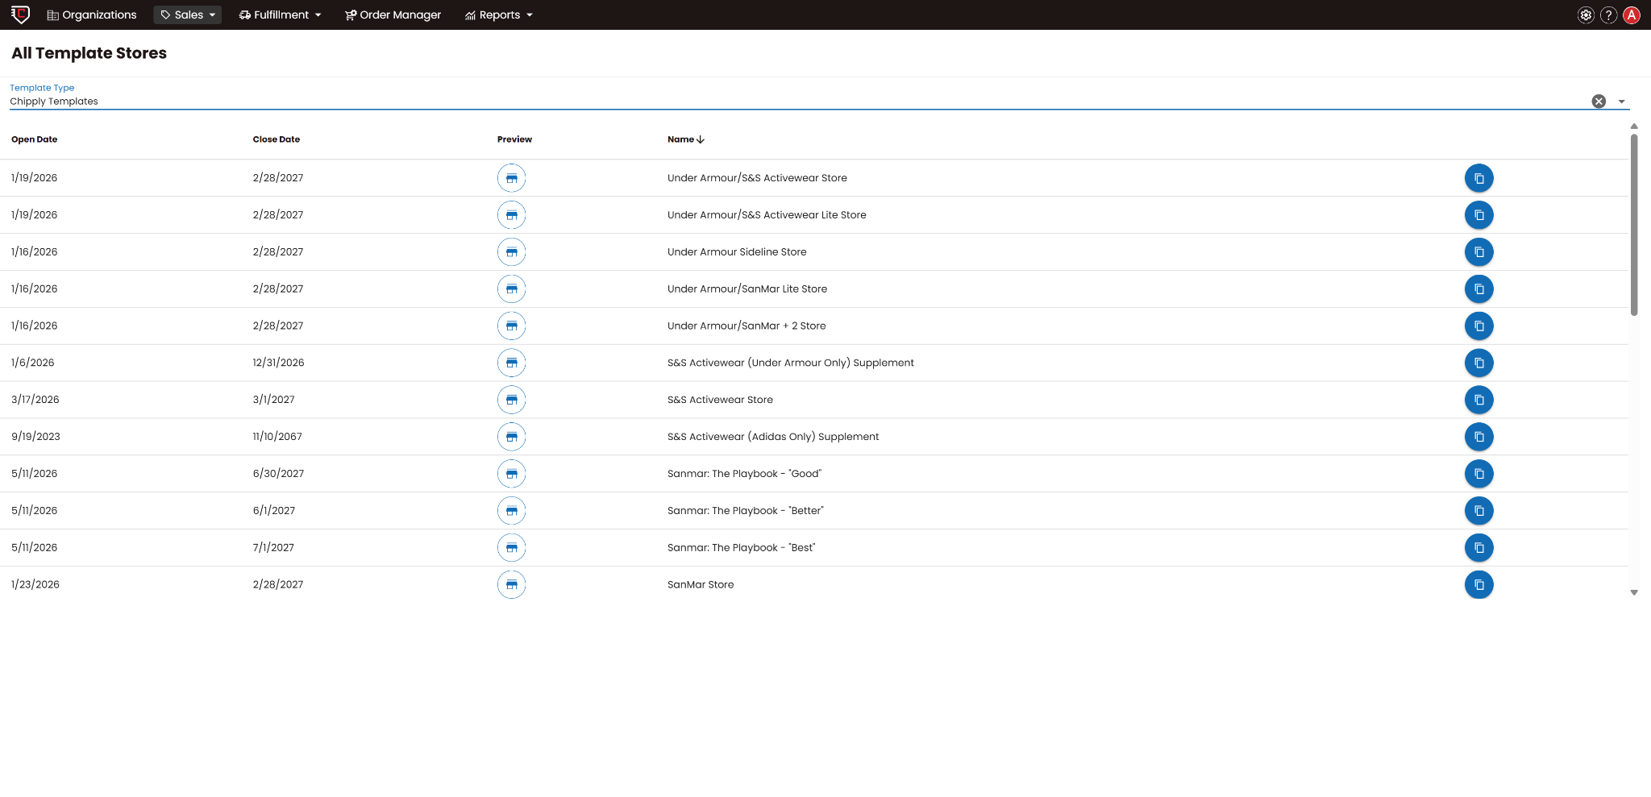
BEST PRACTICES
SETUP
Templates — Chipply or Your Own
WHAT IT IS
Reusable store blueprints that allow you to replicate winning setups instantly. You can choose from pre-built Chipply templates or design your own custom configurations.
Pre-Loaded Settings: Keeps products, branding, fulfillment processes, and pricing structures saved and ready to deploy.
Flexible Customization: Built to serve as an exact starting point that you can quickly tweak to fit a new customer’s unique needs.
WHY IT MATTERS
Multiplying your efficiency, while turning what used to be a hours-long setup process into a repeatable, mistake-proof 15-minute launch; with Guaranteed Pricing & Product Consistency.
Scale Without Extra Workload: Drastically reduces repetitive data entry, allowing your team to handle an influx of new store requests without needing more staff or extra hours.
Templates Best Practices
Templates — Chipply or Your Own
CHIPPLY • CONFIDENTIAL
Notes:
*elle updated 5/19

Slide 7
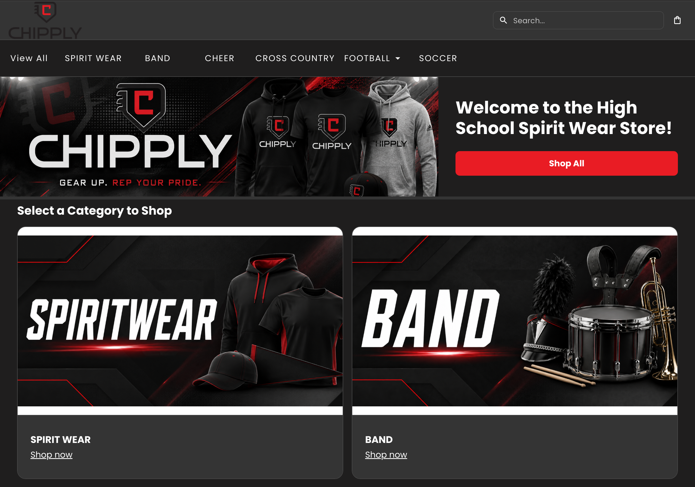
BEST PRACTICES
SETUP
Category Spotlight Images
WHAT IT IS
Give every category its own image. Step up your store's branding by uploading custom artwork per category so the landing page renders as a branded tile grid. Allow customers to see and feel the brand immediately from their first visit.
WHY IT MATTERS
The landing page is the first thing every shopper sees, and it sets whether the store reads as the school's or the company's brand. Tiles turn categories into visual navigation and a sneak preview of the items inside. One card per category, each with its own image, name, and Shop now link, along with the plain text navigation bar on top.
The eid 582683 store — hero banner and branded category tiles on one screen.
SEE IT LIVE
Spirit wear store example ↗
Corporate store example ↗
Category Spotlight Images
CHIPPLY • CONFIDENTIAL

Slide 8
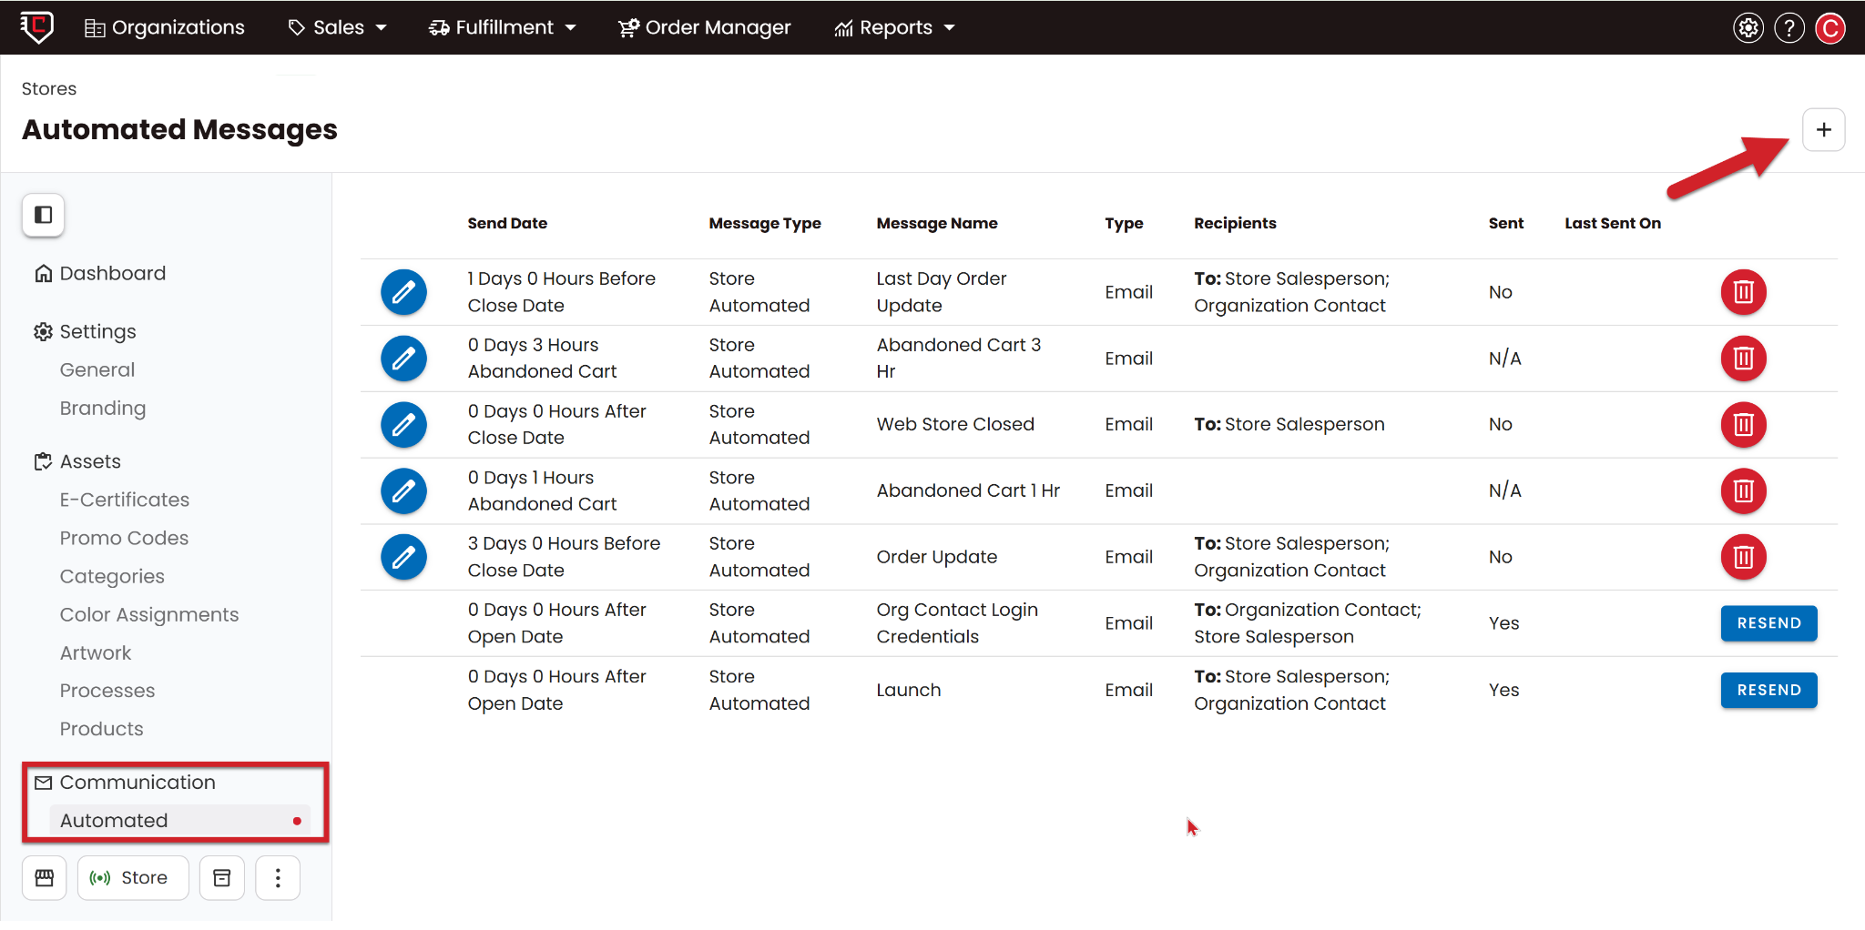
BEST PRACTICES
SELLING
Automated Message/ Message Templates
WHAT IT IS
Drive Traffic & Cut Down Support Questions: A built-in communication engine that automatically schedules and sends targeted store emails—including launch announcements, countdown reminders, abandoned cart notifications, and order updates.
WHY IT MATTERS
Automated messages eliminate the manual work of managing customer communication, driving repeat traffic to your stores while drastically cutting down on inbox clutter.
Hands- Off Store Launches
Smart Dynamic Fields
Fully Customized
Fewer “where is my order?” Questions
DOCUMENTATION
Chipply’s Automated Emails
Automated Message/ Message Templates
CHIPPLY • CONFIDENTIAL
Notes:
*elle updated 5/19

Slide 9
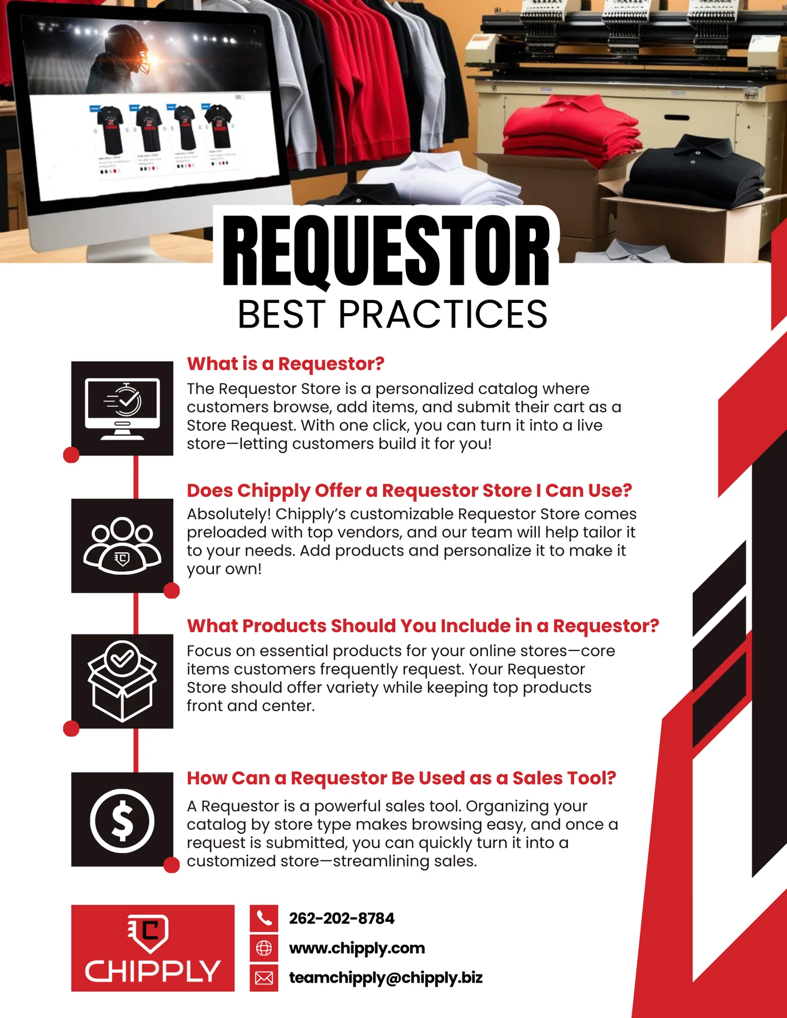
BEST PRACTICES
SELLING
Requestor Store
WHAT IT IS
A personalized digital catalog where your clients browse pre-approved apparel options, add their favorites to a cart, and submit them as a "Store Request" instead of a finished order.
WHY IT MATTERS
Streamlining the consultation process into a professional, self-serve channel that saves time and offers your customers your expertise on industry trends.
Steers Smarter Product Choices: Instead of letting customers pick unvetted items, you guide them toward your top, reliable products to ensure a successful store run.
Captures New Opportunities: Easily turns casual product inquiries into official store requests, ensuring no potential program or team deal slips through the cracks.
What is a Requestor Store?
Requestor Store
CHIPPLY • CONFIDENTIAL
Notes:
*elle updated 5/20

Slide 10
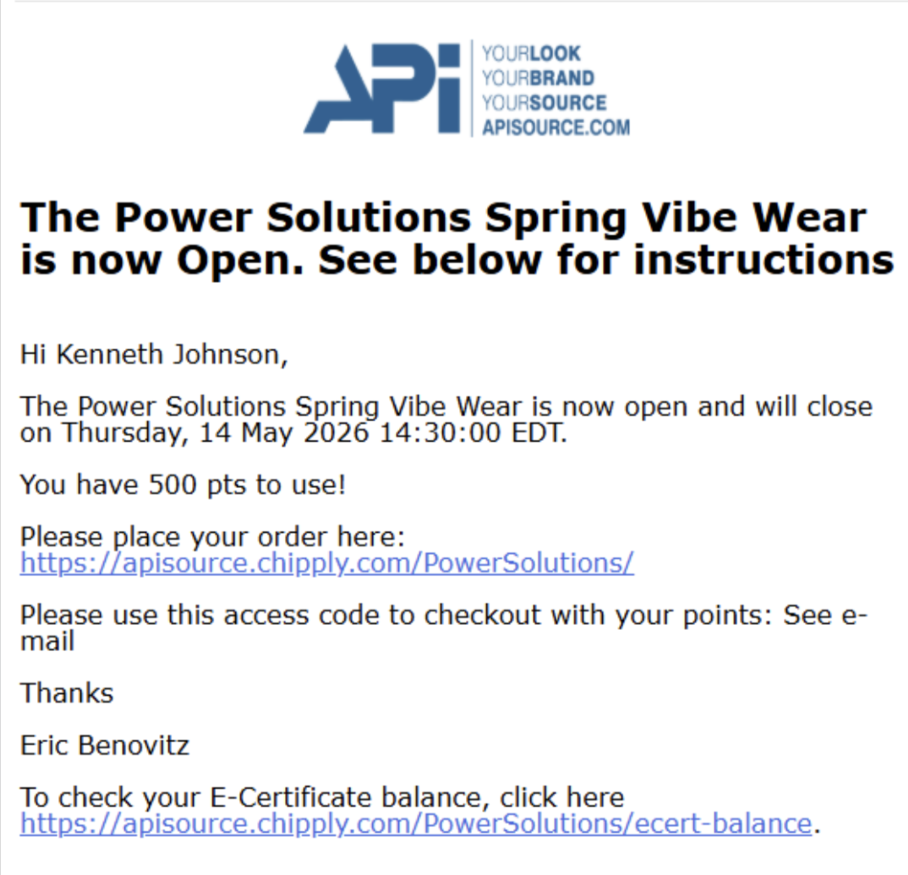
BEST PRACTICES
SELLING
E-Certificates & Promo Codes
WHAT IT IS
A flexible promotion and allotment management system that handles e-certificates and promo codes. It allows you to create custom rewards, support coach or employee buy-in programs, bulk-upload codes, transfer credits between stores, and track real-time usage across storefronts.
WHY IT MATTERS
E-certs and Promo codes serves as your biggest average order value (AOV) and repeat-purchase lever, letting organizations partially or fully cover order costs for their end users.
Powers Flexible Group Funding
Drives Larger Cart Sizes
Streamlined Credit Management
DOCUMENTATION
E-certificates & Promo Codes Best Practices
E- Certificates & Promo Codes
CHIPPLY • CONFIDENTIAL
Notes:
*elle updated 5/21

Slide 11
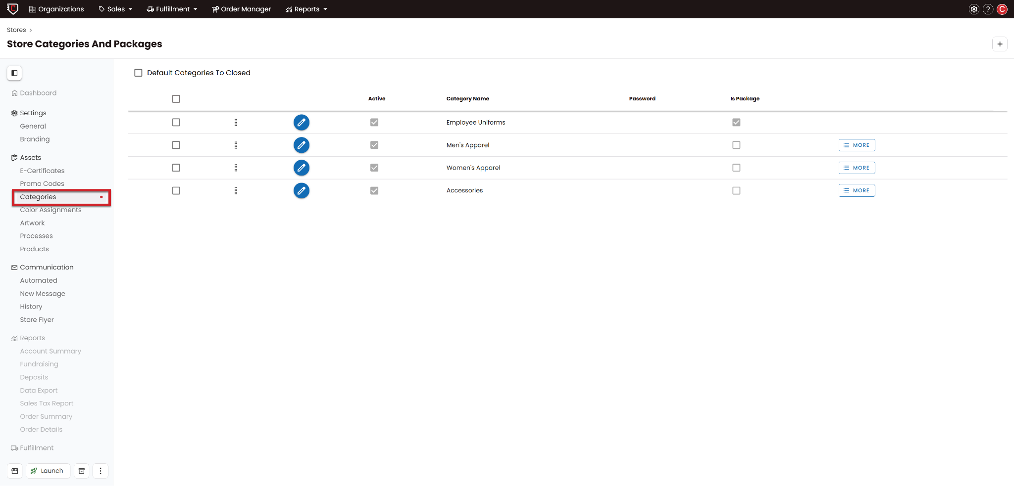
BEST PRACTICES
SELLING
Categories & Packages
WHAT IT IS
Group products into shoppable categories and bundle items into Packages (e.g., team uniform kits). It allows you to build clean, structured storefront layouts while supporting advanced features like password-protected access and dealer-level category templates.
WHY IT MATTERS
These drastically simplifies the shopping experience for complex programs, ensuring buyers find exactly what they need while effortlessly driving up average order value.
Simplifies Store Navigation
Guarantees Order Accuracy
Lifts Average Order Value:
DOCUMENTATION
How to Add a Category or Package to Your Store
Categories & Packages
CHIPPLY • CONFIDENTIAL
Notes:
*elle updated 5/21

Slide 12
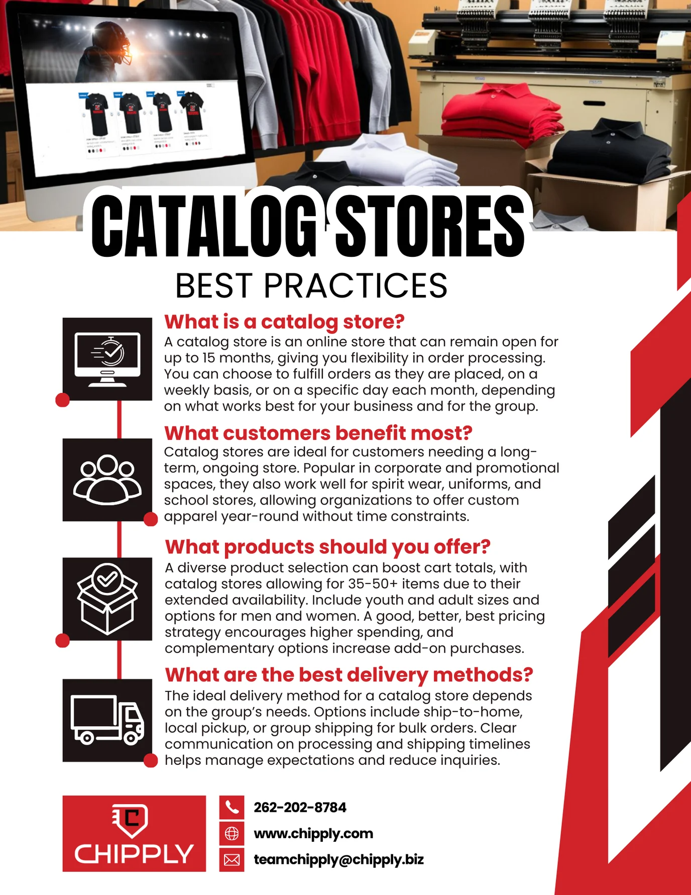
BEST PRACTICES
SELLING
Catalog Stores & Batching
WHAT IT IS
An always-on storefront solution that allows you to collect orders continuously and automatically group them into scheduled production runs. Instead of opening and closing a store repeatedly, it remains open to buyers year-round while giving you tools like manual force-batching, return-to-parent routing, and automated batch notifications to manage your fulfillment cycles.
WHY IT MATTERS
Powering your perpetual programs—like year-round school spirit shops or ongoing corporate apparel stores—ensuring you can capture non-stop revenue without drowning in constant setup administration.
Powers Perpetual Programs
Secures On-Time Fulfillment
Eliminates Constant Store Rebuilds
What is a Catalog Store?
Catalog Stores & Batching
CHIPPLY • CONFIDENTIAL
Notes:
*elle updated 5/21

Slide 13
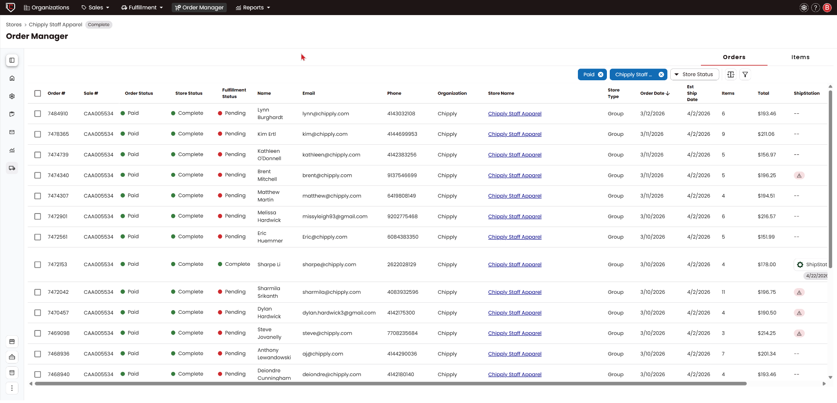
BEST PRACTICES
ORDERS
Order Manager — Orders Tab
WHAT IT IS
Refund, Find, Edit: A centralized customer service dashboard designed to handle post-transaction updates across your stores. It allows you to quickly locate orders, process full or partial refunds, void transactions, add new line items to existing purchases, and adjust non-product fees like tax, shipping, and handling.
WHY IT MATTERS
It serves as your day-to-day customer service engine, giving your team the exact toolkit needed to resolve shopper requests in a single, efficient interaction.
Single-Reply Resolutions
Granular Financial Control
Smarter Problem Solving
View Order Manager Help Articles
Order Manager — Orders Tab
CHIPPLY • CONFIDENTIAL
Notes:
*elle updated 5/21

Slide 14
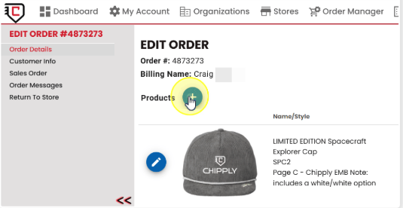
BEST PRACTICES
ORDERS
Order Manager- Items Tab
WHAT IT IS
A product-focused fulfillment dashboard that isolates individual line items across your orders. While the Orders Tab organizes transactions by the buyer, the Items Tab breaks down exactly what needs to be produced or managed—giving you a dedicated space to track backorders, monitor items pending vendor restocks, and route products efficiently once they become available.
WHY IT MATTERS
Visibility into backordered items, preventing lost revenue and stale purchase orders by ensuring delayed products never slip through the cracks.
Maintains Organization Control
Protects Your Revenue
Streamlines Production Routing
DOCUMENTATION
View Order Manager Help Articles
Order Manager- Items Tab
CHIPPLY • CONFIDENTIAL
Notes:
*elle updated 5/21

Slide 15
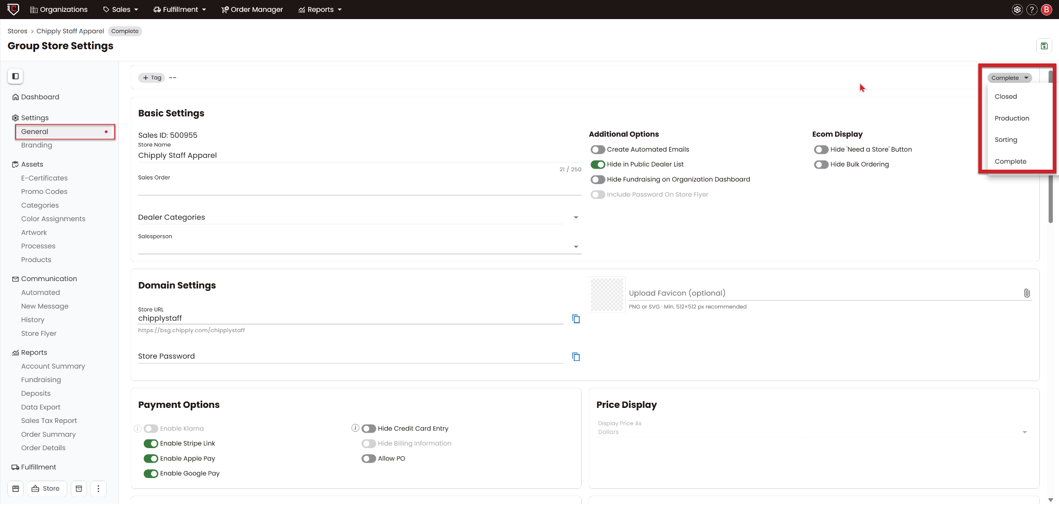
BEST PRACTICES
ORDERS
Assigning Correct Store Status
WHAT IT IS
Define and update each store's operational phase—either individually or in bulk—to keep your dashboard organized and your reporting accurate. It serves as your team's tracking framework, ensuring every storefront is clearly categorized from initial setup all the way to completion.
WHY IT MATTERS
It acts as your operational filing cabinet, providing company-wide visibility into store progress while protecting your live workflow.
Keeps Production Clean
Prevents Accidental Re-openings
Company-Wide Visibility
DOCUMENTATION
Organize Your Stores Using Store Status
Assigning Correct Store Status
CHIPPLY • CONFIDENTIAL
Notes:
*elle updated 5/21

Slide 16
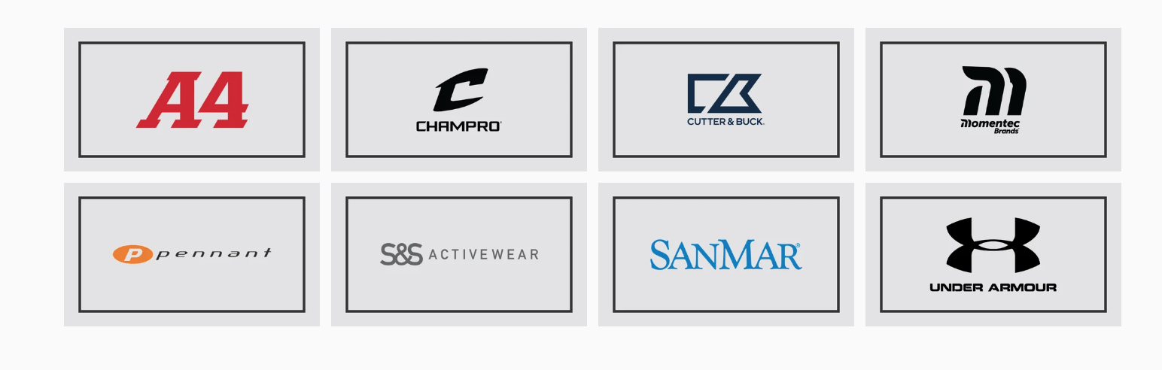
BEST PRACTICES
FULFILLMENT
Purchasing Utility — Vendors
WHAT IT IS
Directly integration your Chipply platform to major wholesale apparel brands like SanMar, S&S Activewear, Augusta, and Under Armour. It links your accounts so you can automatically generate and transmit purchase orders directly to your suppliers without ever leaving the system.
WHY IT MATTERS
It completely eliminates manual data entry, consolidating your wholesale purchasing into a single workflow that gets faster and more valuable the larger your store catalog grows.
Eliminates Manual Data Entry
Drastically Cuts Human Error
Accelerates Order Procurement
DOCUMENTATION
Integrated Purchasing Vendors
Purchasing Utility — Vendors
CHIPPLY • CONFIDENTIAL
Notes:
*elle updated 5/21

Slide 17
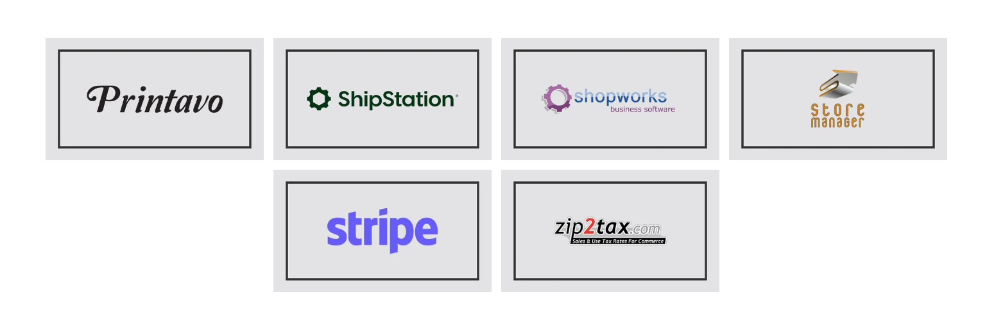
BEST PRACTICES
FULFILLMENT
Other Integrations — ShipStation & More
WHAT IT IS
A suite of third-party platform connections that plug Chipply directly into your existing production, shipping, and business software. Featuring deep integrations with ShipStation (for complete account setup and order transmission), Printavo, ShopWorks, and Fulfill Engine, ensuring your backend tools seamlessly share data.
WHY IT MATTERS
Plug Chipply into your existing production stack. No double entry, faster label time, and order status stays in sync everywhere.
Eliminates Double Data Entry
Speeds Up Shipping Label Creation
Keeps Order Statuses Synced Everywhere
How to Set Up Your ShipStation Integration
Other Integrations — ShipStation & More
CHIPPLY • CONFIDENTIAL
Notes:
*elle updated 5/21

Slide 18
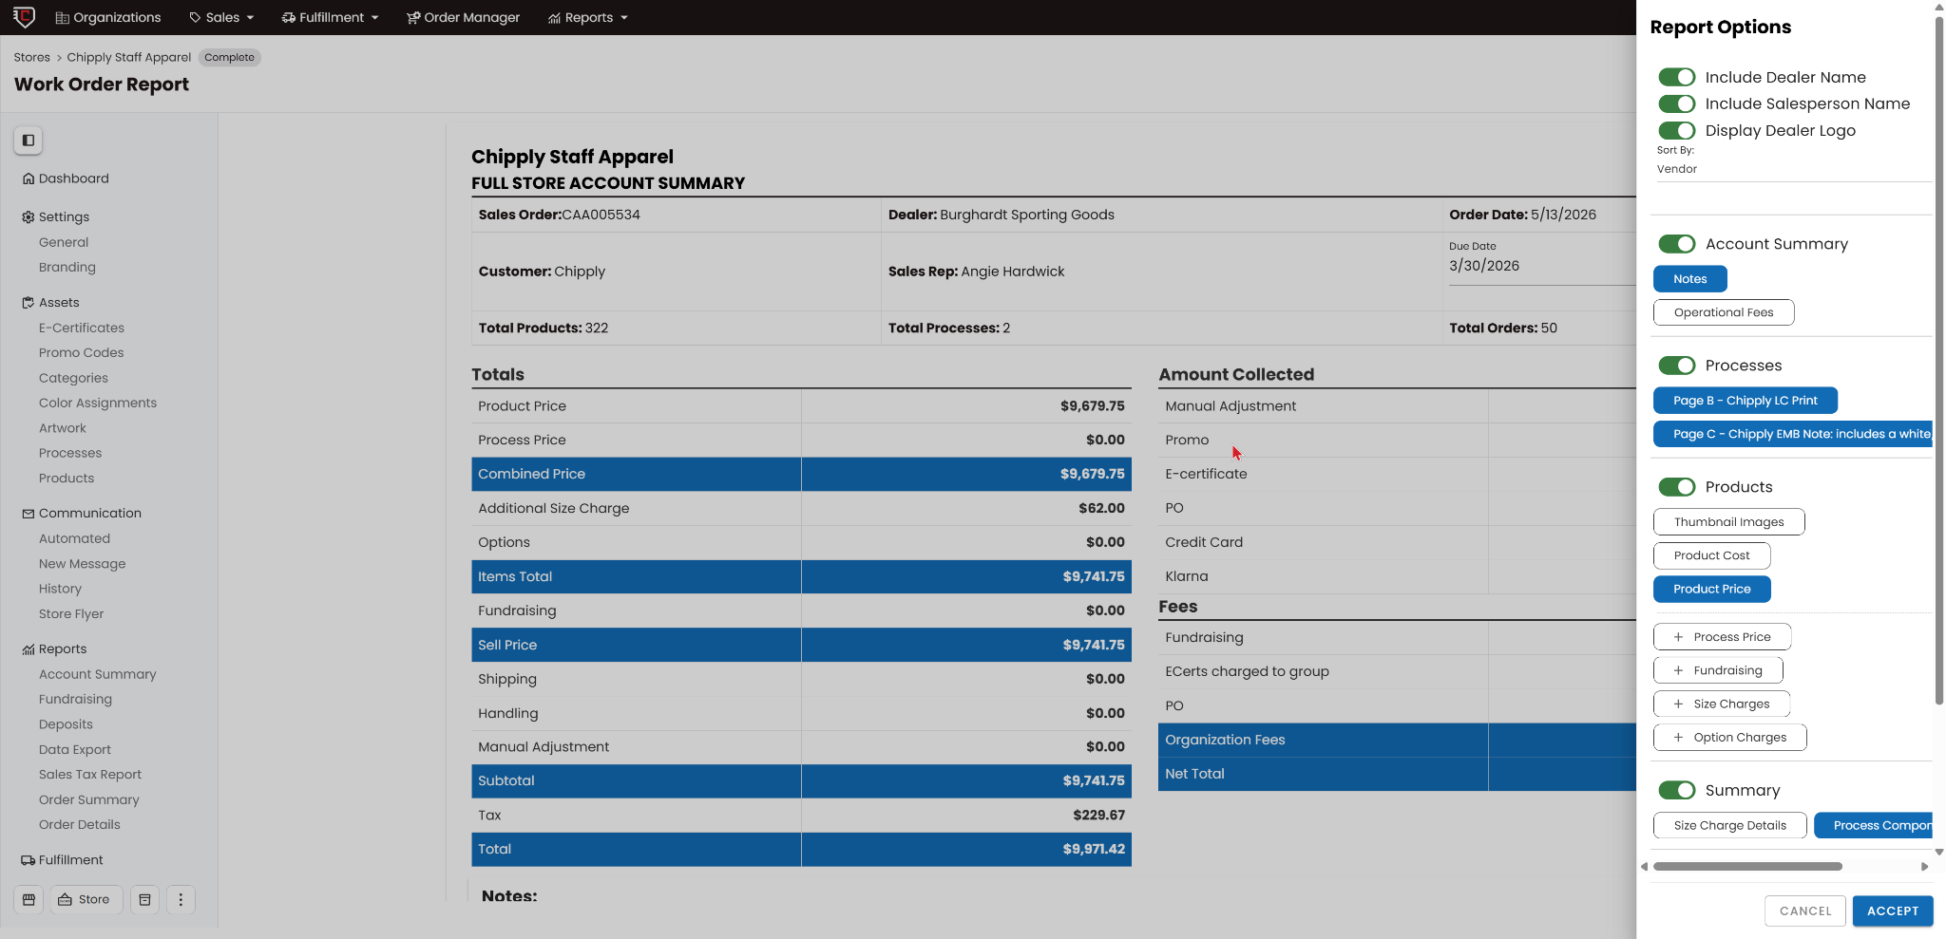
BEST PRACTICES
FULFILLMENT
Fulfillment Tools — Work Orders & Sorting
WHAT IT IS
A powerhouse fulfillment system that automatically generates comprehensive production blueprints and manages your purchasing and packing queue.
WHY IT MATTERS
Your production floor's daily engine. Master these tools to turn chaotic post-close processing into a flawless, high-speed pick-pack run.
Building your store automatically builds work orders, closing a store instantly hands you complete production documents- paired with a step-by-step numerical sorting system to guide your team from the production floor to the final shipping bag.
DOCUMENTATION
Store Closing Help Articles
Fulfillment Tools — Work Orders & Sorting
CHIPPLY • CONFIDENTIAL
Notes:
*elle updated 5/21

Slide 19
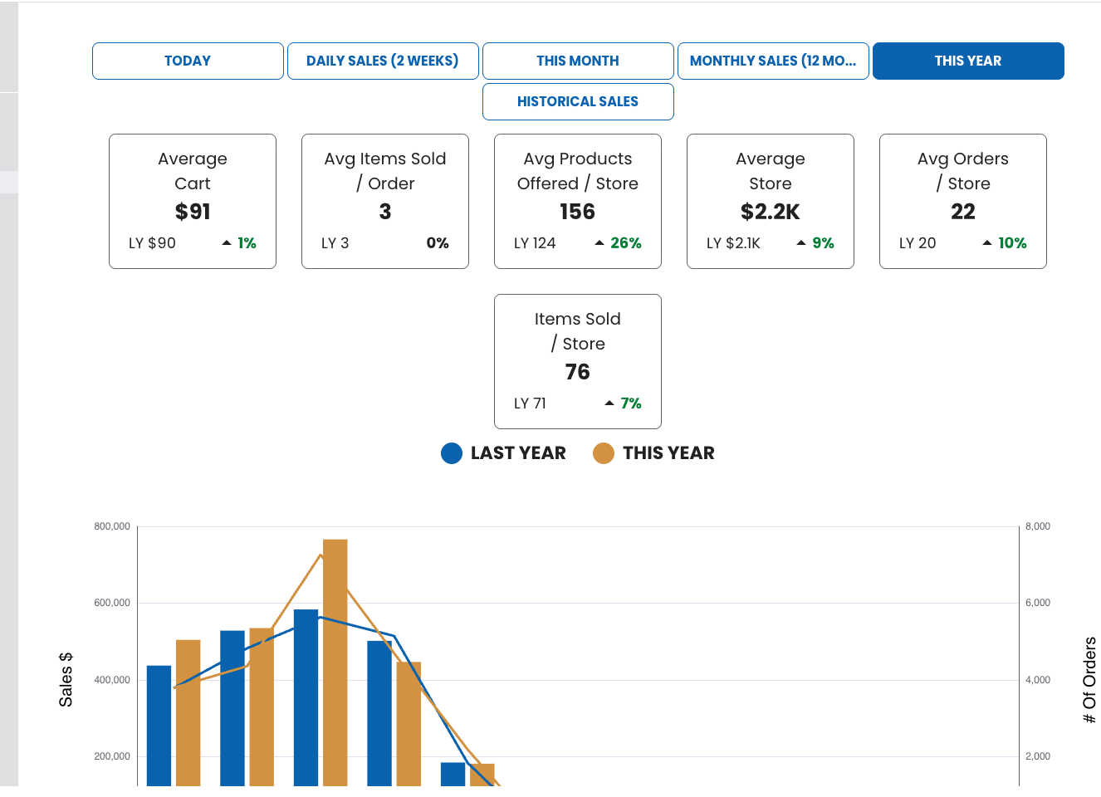
BEST PRACTICES
GROWTH
Accounting — Pulling Reports
WHAT IT IS
A robust financial tracking engine loaded with custom and downloadable datasets. Whether you need an analytical Excel export for intense data parsing or a clean, ready-to-print PDF report for a quick summary, the system offers flexible layouts covering Order Details, fundraising filtering, and targeted export options.
WHY IT MATTERS
Hours of spreadsheet wrangling, gone. Pull hyper-targeted datasets to reconcile to QuickBooks instantly, true up sales team commissions flawlessly, and effortlessly prove fundraising payouts.
Reconciles Directly to QuickBooks
Automates Commission Calculations
Simplifies Fundraising Payout Audits
Offers Flexible Excel and PDF Formats
Chipply Reporting Webinar Recording
Accounting — Pulling Reports
CHIPPLY • CONFIDENTIAL

Slide 20
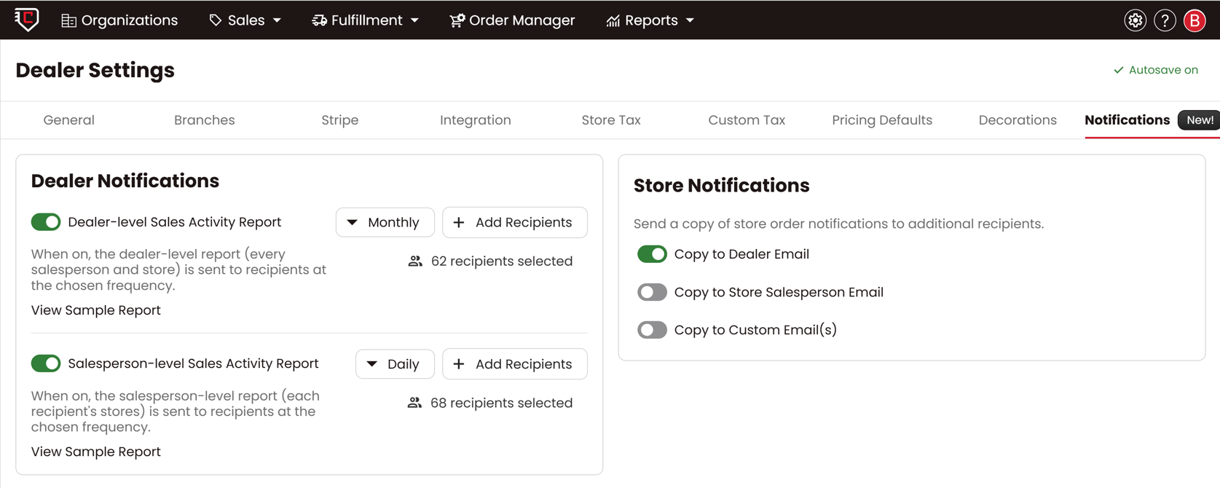
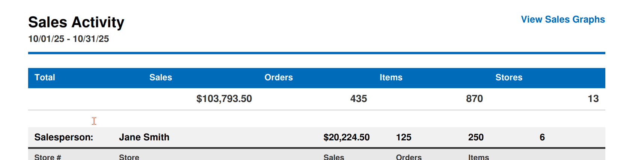
BEST PRACTICES
GROWTH
Sales Activity Reports
WHAT IT IS
A scheduled email report: sales activity across your stores and salespeople, delivered daily, weekly, or monthly. Two levels: Dealer-level covers every salesperson and store; Salesperson-level covers only that rep's own stores. You pick the frequency and the recipients.
WHY IT MATTERS
Nobody has to log in and pull a report to know how the week went. Owners see the whole account at a glance; reps get their own numbers without seeing each other's. A slow store shows up while there is still time to do something about it.
Dealer Settings › Notifications — both report types, frequency, and recipients.
DOCUMENTATION
Setting Up Sales Activity Reports
What lands in the inbox.
Sales Activity Reports
CHIPPLY • CONFIDENTIAL

Slide 21
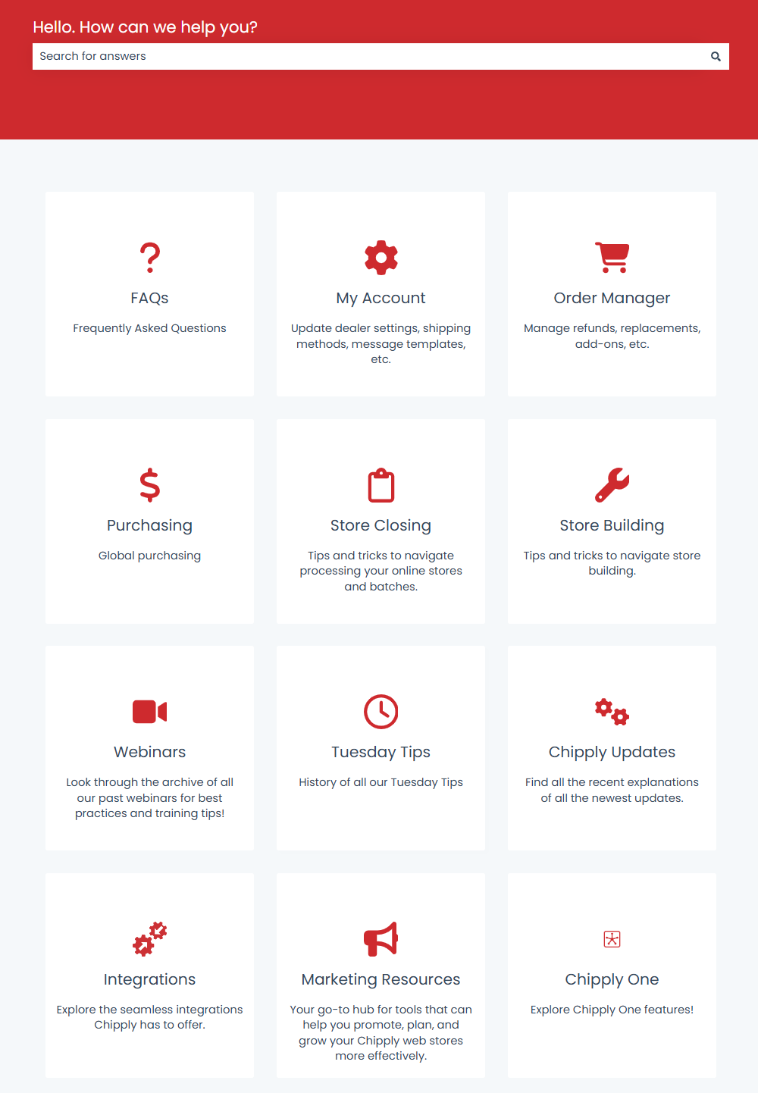
BEST PRACTICES
GROWTH
Resources Hub
WHAT IT IS
A centralized, self-serve knowledge base packed with step-by-step guides, walkthrough videos, and rich visual assets. Offering an on-demand library to find answers, troubleshoot store settings, and explore platform capabilities independently without needing to pick up the phone.
WHY IT MATTERS
Instant answers right when needed. Empowering our customers to solve their own questions on the spot, using clear visuals so they never feel stuck or have to wait around for help.
Speeds Up Problem Solving
Delivers Clear Visual Clarity
Eliminates Waiting for Answers
Builds Total Platform Confidence
Visit chipply.com/resources
Resources Hub
CHIPPLY • CONFIDENTIAL
Notes:
*elle updated 5/21

Slide 22
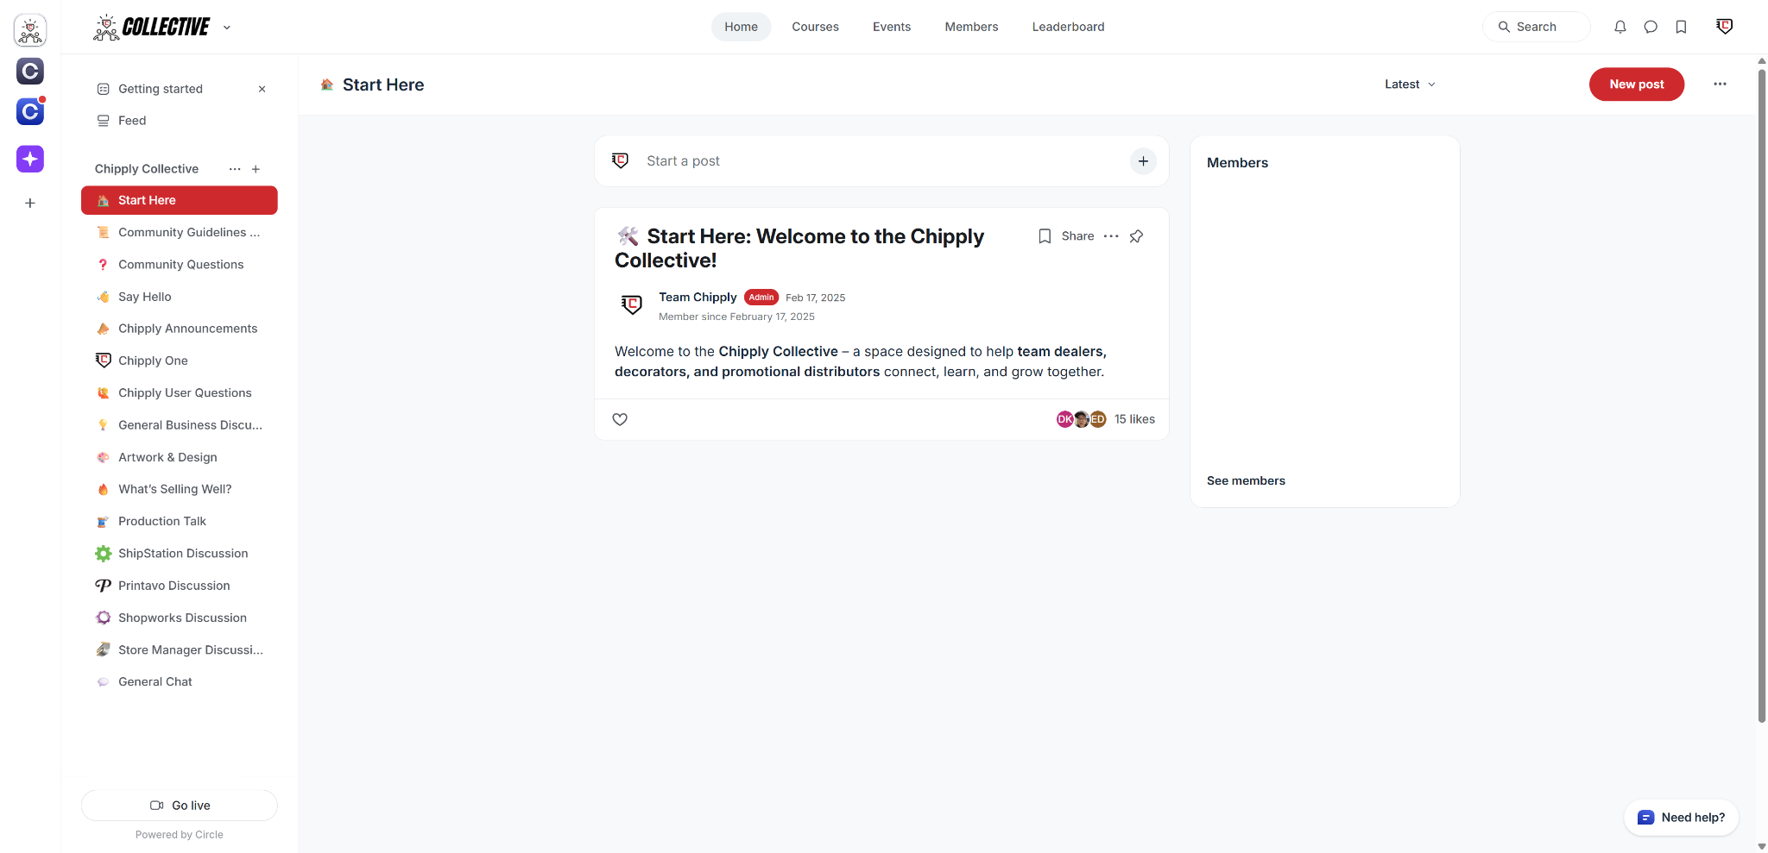
BEST PRACTICES
GROWTH
The Chipply Collective
WHAT IT IS
An exclusive peer-to-peer community hosted on Circle, built specifically for team dealers, decorators, and promotional distributors. It serves as your collaborative industry hub for swapping Chipply master-tips, diving into open business discussions, and sharing real-world artwork and production workflows directly with other pros.
WHY IT MATTERS
Tap into the collective brainpower of the industry. It’s your active roundtable to bounce ideas off one another, crowdsource immediate answers, and swap winning strategies to crush your seasonal pushes.
Crowdsources Immediate Answers
Fosters Peer-to-Peer Collaboration
Unlocks Shared Production Hacks
Discovers Trending Industry Ideas
Introducing the Chipply Collective
The Chipply Collective
CHIPPLY • CONFIDENTIAL
Notes:
*elle updated 5/21

Slide 23
CHAMPIONS TRUST
CHIPPLY.
Questions? Reach out to your Team Chipply or visit help.chipply.com.

